Slide 1
ECO346 Assignment 1
Data Visualization Techniques for Economists
Meesam Rizvi | FA24-BEDS-071
Variant 7: Urban Balochistan, Pakistan
PSLM 2019–20 • Positive annual earnings • Ages 15–64

Slide 2
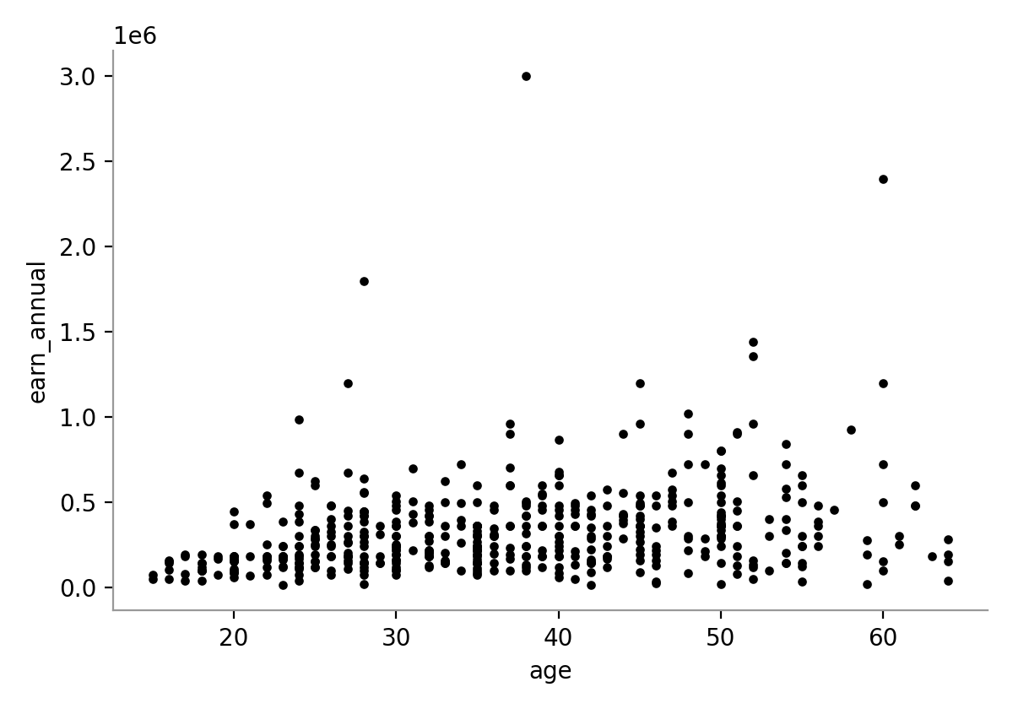
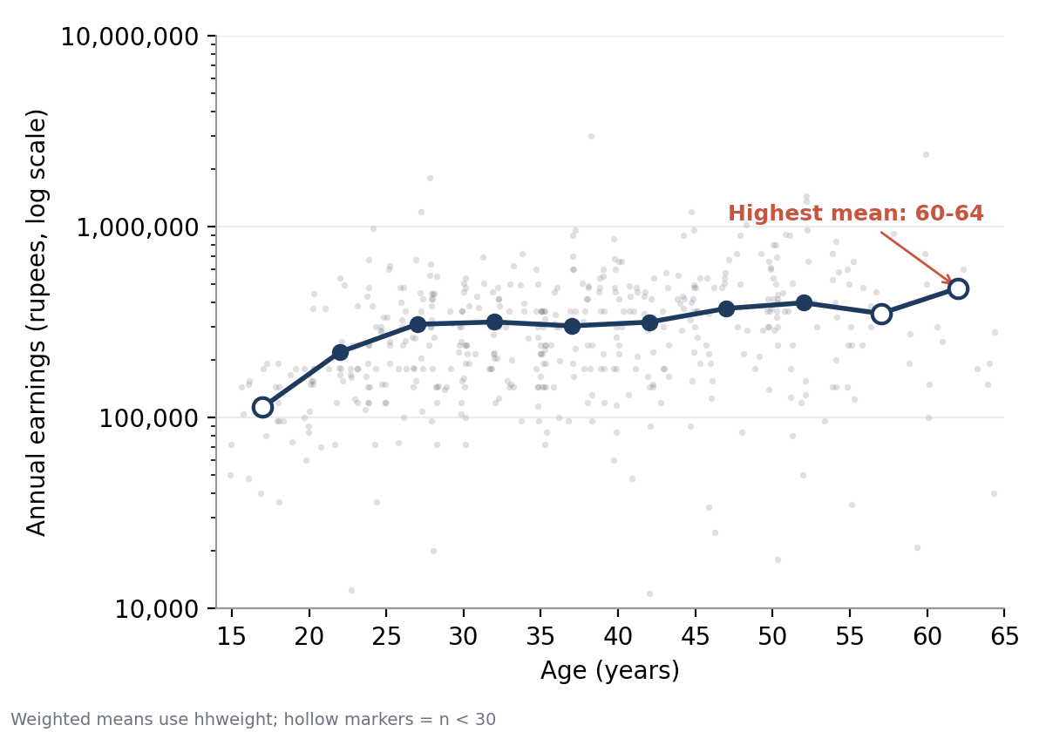
Redesign turns a cloud of dots into a readable age profile
Default scatter (left) vs redesigned figure (right)
Default: raw axes, no scale guidance, heavy overplotting at low earnings.
Redesign: log earnings axis, jittered points, weighted age-band means, hollow markers for n < 30, highest-mean label.
ECO346 Assignment 1 | Meesam Rizvi | FA24-BEDS-071
2

Slide 3
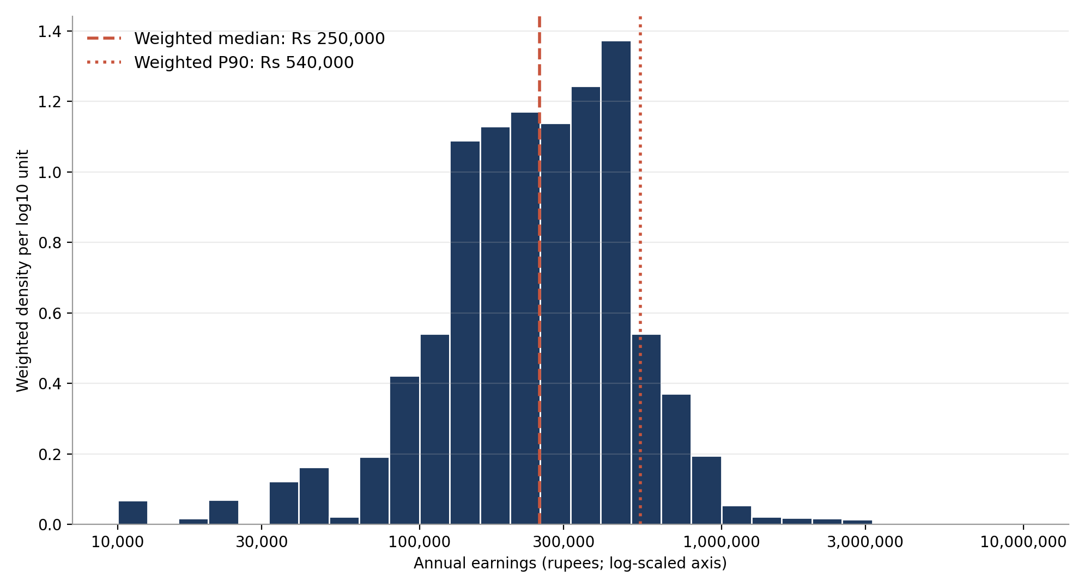
Median urban earner makes Rs 250,000; spread is wide
Distribution of positive annual earnings, weighted by hhweight
Rs 96,000
Weighted P10
Rs 250,000
Weighted median
Rs 540,000
Weighted P90
5.6×
P90 / P10 ratio
N = 486 earners; 0 fall outside the plotted range (10,000 to 10,000,000). Unweighted median: Rs 264,000.
ECO346 Assignment 1 | Meesam Rizvi | FA24-BEDS-071
3

Slide 4
Earnings rise with age, peaking at 60–64
Weighted mean annual earnings by 5-year age band
Age band | n | Weighted mean (Rs)
15-19 | 22 | 113,382
20-24 | 56 | 220,435
25-29 | 69 | 307,994
30-34 | 62 | 316,659
35-39 | 80 | 302,071
40-44 | 60 | 316,147
45-49 | 47 | 372,723
50-54 | 55 | 399,250
55-59 | 19 | 350,772
60-64 | 16 | 476,422
Red rows: n < 30, interpret with caution. Peak band 60–64 has n = 16.
ECO346 Assignment 1 | Meesam Rizvi | FA24-BEDS-071
4

Slide 5
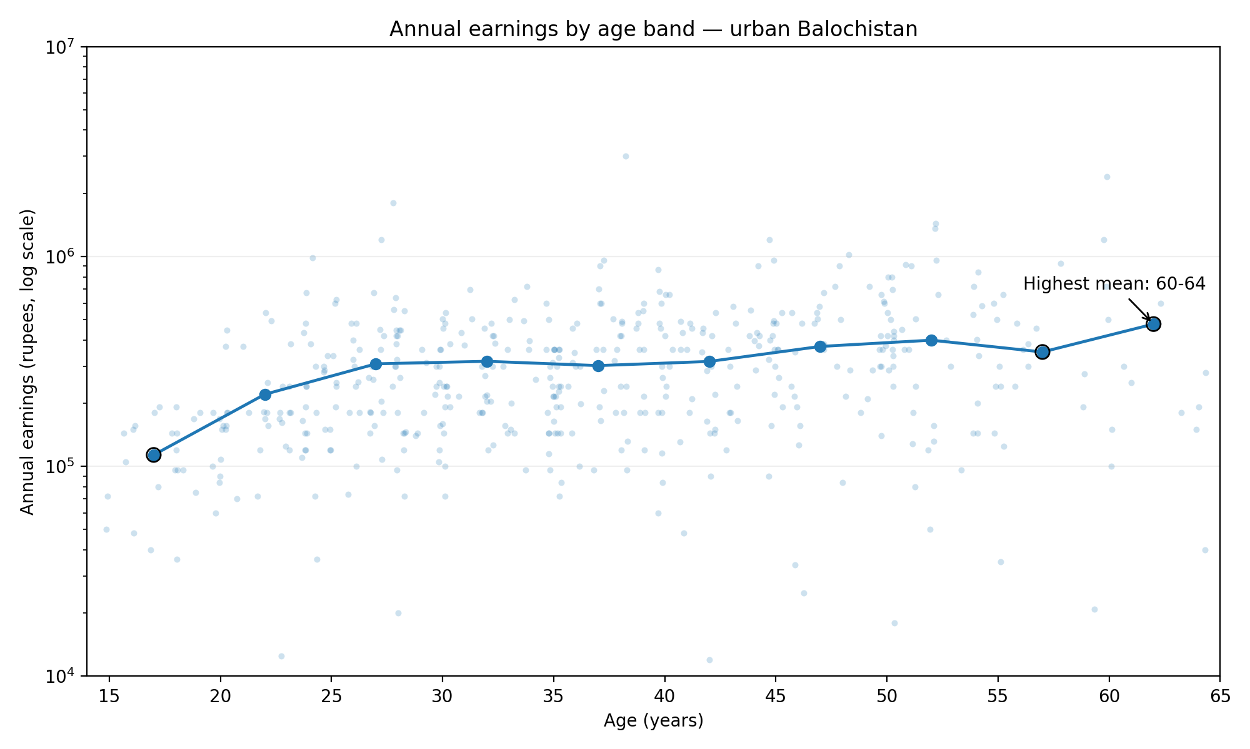
Python version confirms the age-band pattern
Q5: pandas + matplotlib version of the age profile
Sample: 486 earners (Balochistan, urban, ages 15–64, earnings > 0).
Method: bands start at 15; means weighted by hhweight with np.average.
Result: lowest mean in 15–19 (Rs 113,382), highest in 60–64 (Rs 476,422).
Three bands have n < 30 (15–19, 55–59, 60–64), shown as ringed markers.
Figure produced by the Q5 Python script; table saved as q5_python_age_band_table.csv.
ECO346 Assignment 1 | Meesam Rizvi | FA24-BEDS-071
5

